Slide 1

MyLegion:
Group Profile – Understanding My Groups
2025

Slide 2
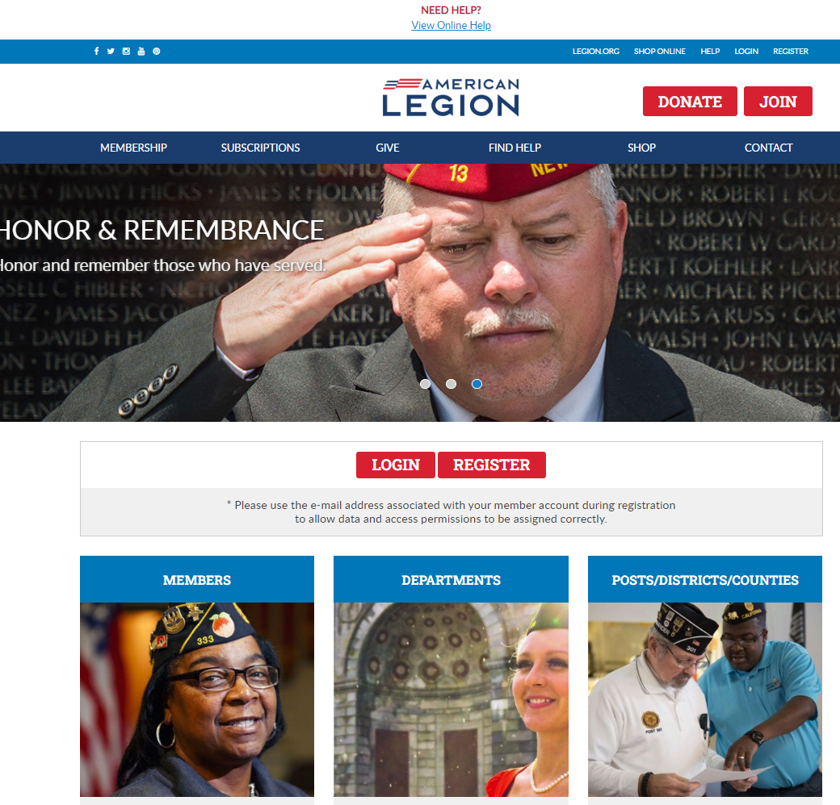
Notes:
MyLegion provides information on file at Department and National Headquarters. Log in to view membership details and access administrative tools for leadership.

Slide 3
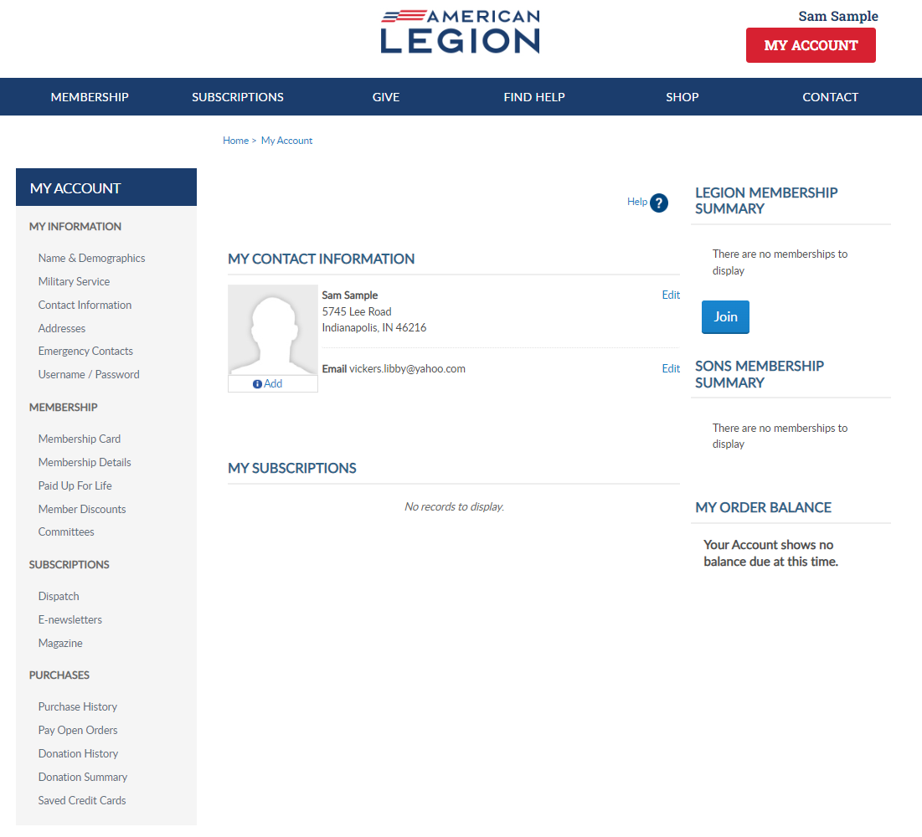
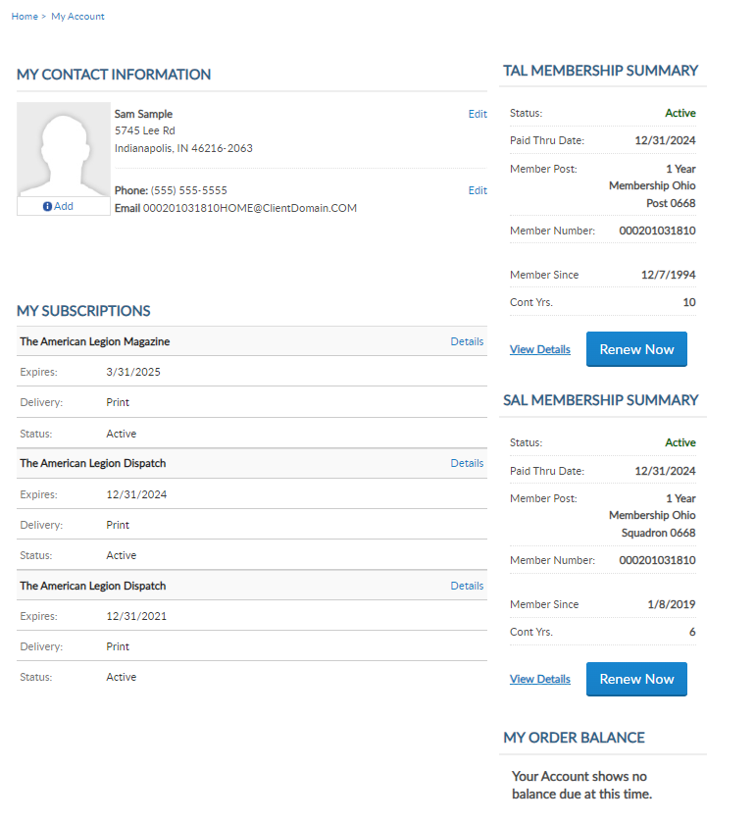

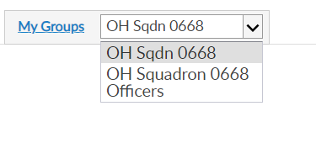
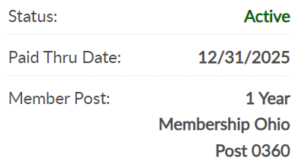
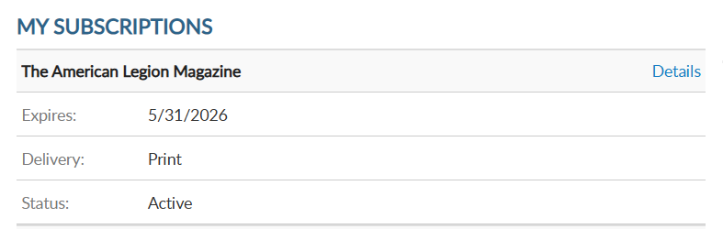

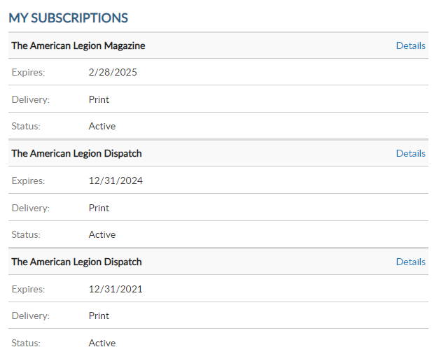
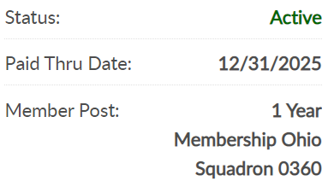

000123456789
PrimaryEmailAddress.com
000123456789
Notes:
My Groups is available when the member is recorded as an adjutant or commander of a post, squadron, district, county, department and detachment. The group menu is related to your position.
Adjutants and commanders, through their individual accounts, will have a My Groups area to assist with post and squadron administrative tasks. A post officer will have access to both Legion and Sons of the American Legion membership. SAL officers will have a menu with 2 groups. <1>

Slide 4
GROUP | ADMINISTRATIVE OFFICERS
Post Post Officer | Post Adjutant & Commander
Squadron Squadron Officer | Squadron Adjutant & Commander
County LGN & SAL County Officer | County Adjutant & Commander View only
District LGN & SAL District Officer | District Adjutant & Commander View only
Detachment Detachment Officer | Detachment Adjutant & Commander
Department Department Officer | Department Adjutant & Commander
GROUP DEFINITIONS
Notes:
Groups are defined as a post, squadron, county, district, detachment and department. Adjutants and commanders have My Groups by default.
With each group, adjutants and commanders will have an officer’s group. Officer groups provide a listing of current and future officers. It is not the group to select to preform administrative tasks.

Slide 5
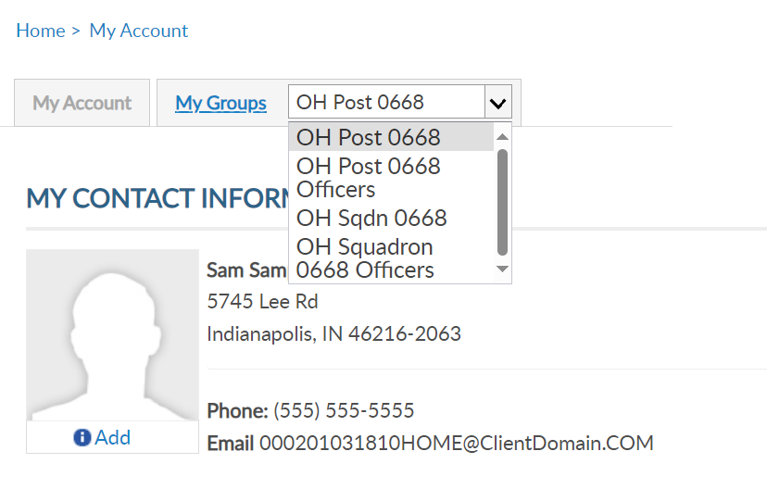
MY GROUPS
Squadron Adjutant
LGN Leadership has LGN and SAL data
Officer Groups: view only
000123456789
PrimaryEmailAddress.com
000123456789
Notes:
This member is a squadron adjutant. <1> Legion leadership will have Legion and SAL data. <2> Officer groups are view only. Officer groups lists the officers on file.
Clicking on the group will navigate you to the administrative side of MyLegion. Let’s look at an officer’s group. <3>

Slide 6
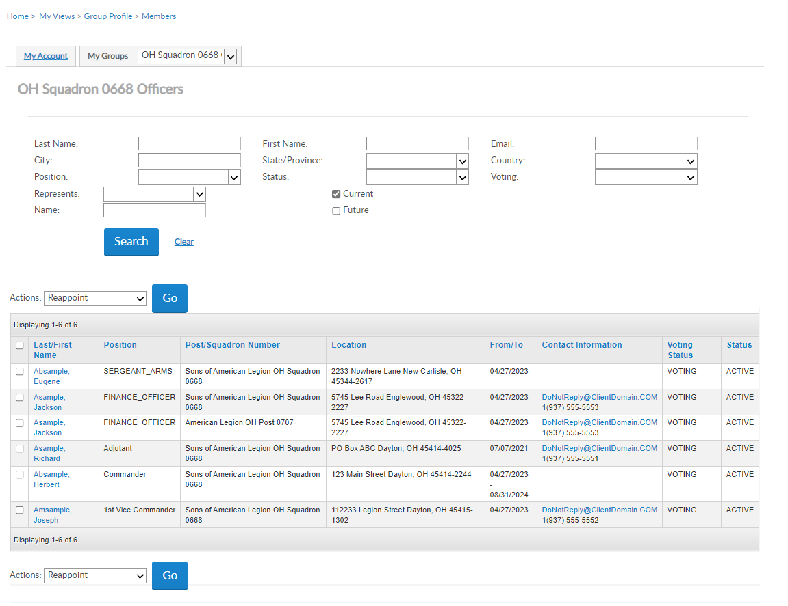


OFFICER GROUPS
Officer Groups: view only
Report Officer updates through Dept HQs using an Officer’s Certification Form
Current & Future Officers
04/27/2025
04/27/2025
04/27/2025
04/27/2026
Notes:
Officer group allows you to view officers reported and entered in national’s membership system. MyLegion does not allow adding or reappointment officers. <1> Report officers through your detachment headquarters using the Officer Certification form. Officer updates cannot be made through MyLegion.
<2> You can view future officers. Click on future and Search to display any future officers reported. <3>

Slide 7
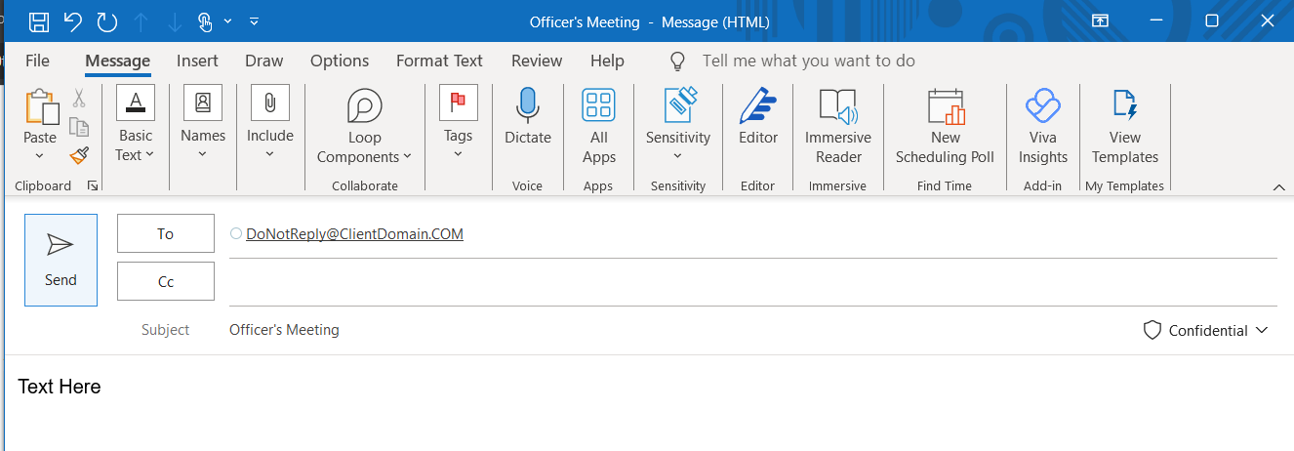
OFFICER GROUPS
Send email to individual from list.
04/27/2025
04/27/2025
04/27/2025
04/27/2026
Notes:
The officer list will allow you to send an email. Click on the email address of a single member and an email will open. <1>

Slide 8
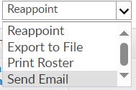

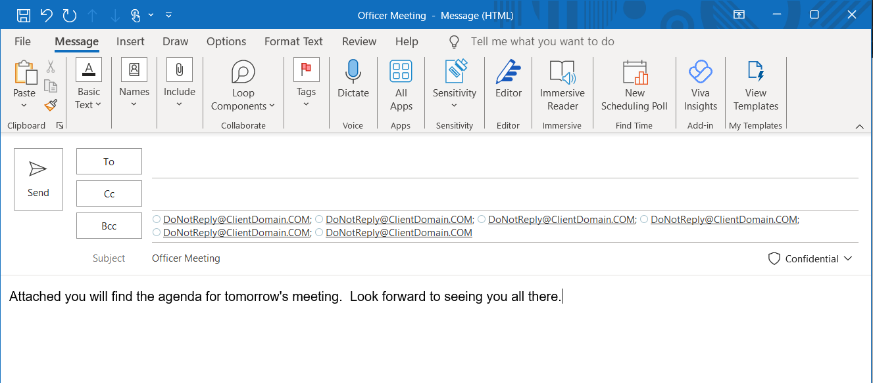
OFFICER GROUPS
Send email to all officers
04/27/2025
04/27/2025
04/27/2025
04/27/2026
Notes:
To email a group of members select the members to email <1> and in the actions menu <2> select send email and click Go. <3> Notice the email addresses are in as a blind copy. Recipients of the email cannot see who else received the message.

Slide 9
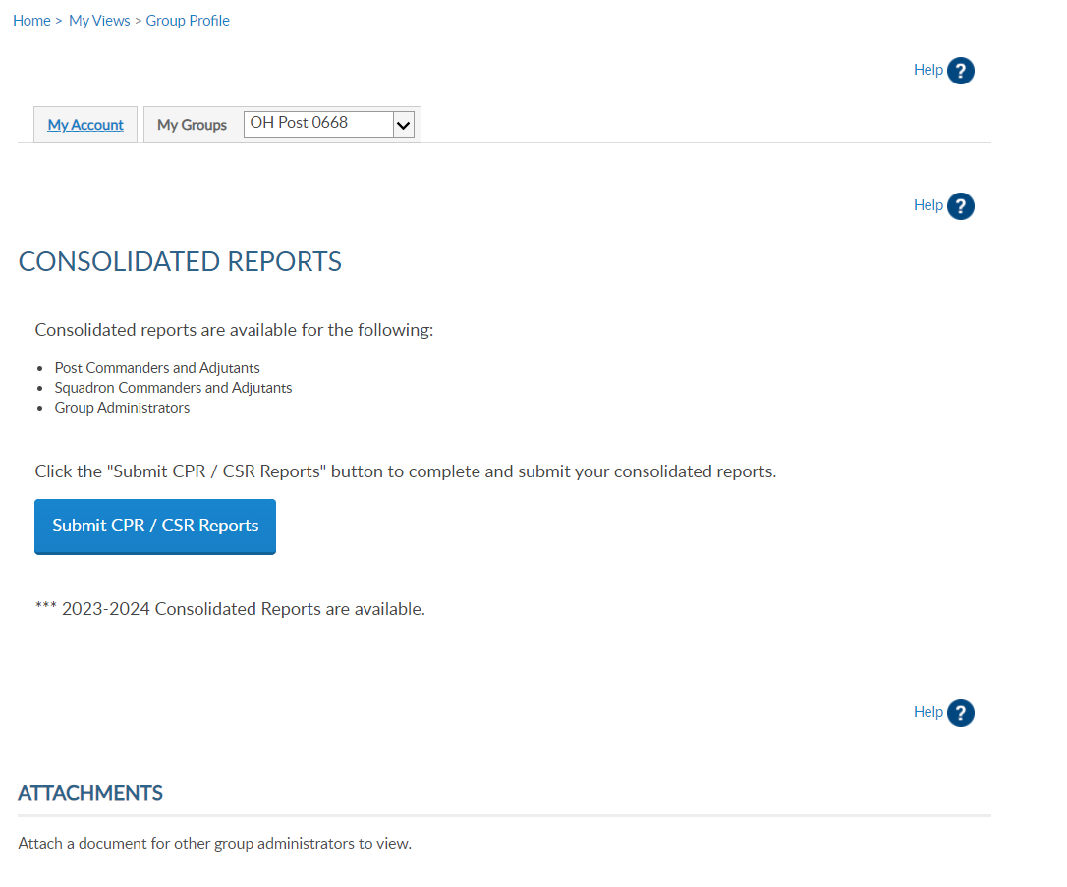
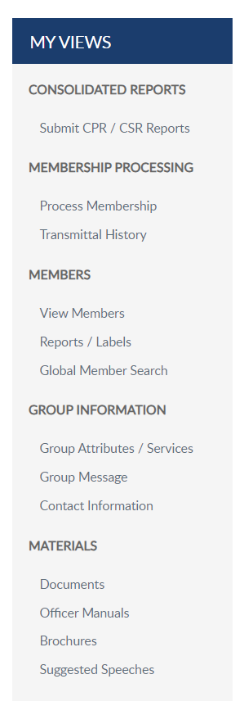
GROUP PROFILE
Notes:
Selecting the squadron group takes you to a Group Profile page which is the administrative side of MyLegion. A new left hand “My Views” menu of administrative tools such as reports, online membership processing, member management, group information and officer materials.

Slide 10
MEMBER INFO
Notes:
View and manage member information using “View Members”. <1> View Members takes you to the membership list.​

Slide 11
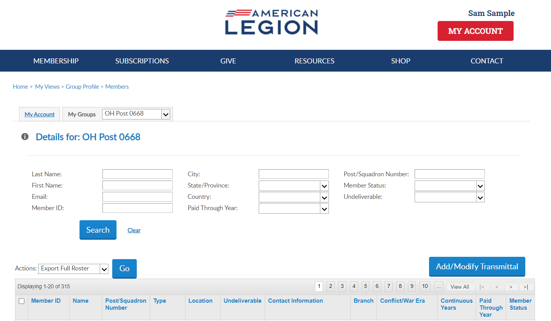
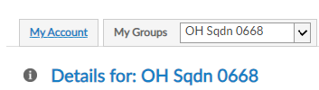
Online Help
Notes:
The members window allows you to search and view members. The list includes all members, active and deceased with a last paid years for current and expired members.

Slide 12
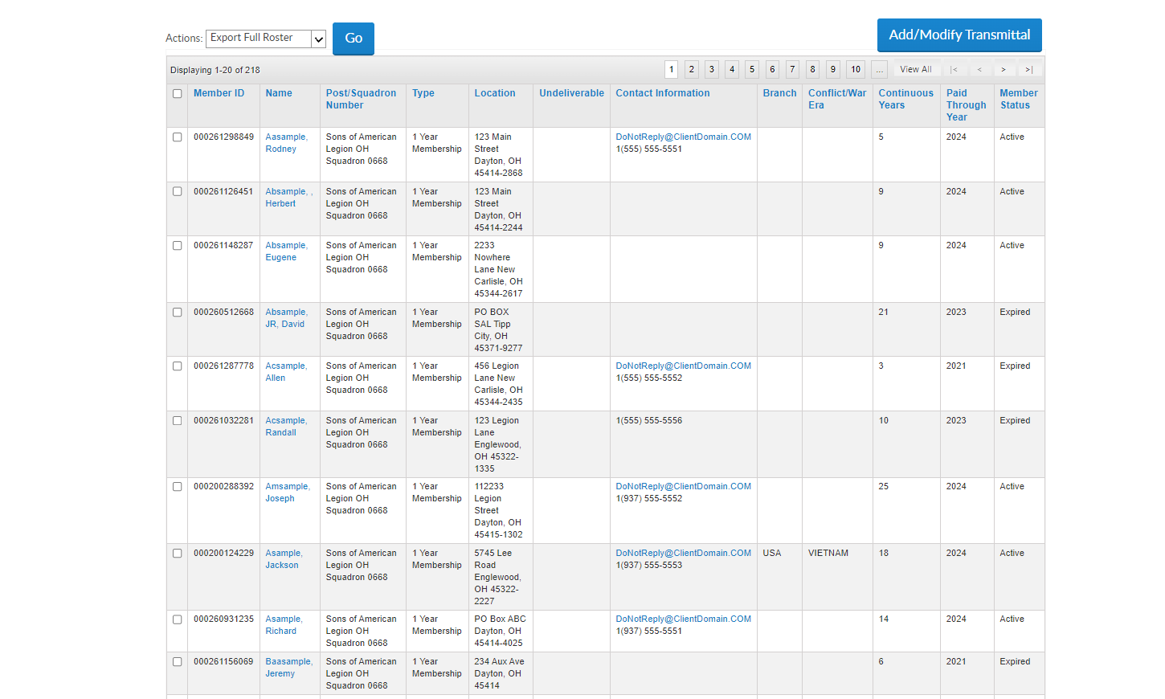
View Members
123456789
2025
122333445
2025
122333444
2025
122333222
2024
122333555
2022
122333400
2024
122333454
2025
122331250
2025
122332251
2025
111331250
2022
Notes:
The member list includes all members of the squadron since I am in the squadron list. It includes current, deceased and expired members. It does not include members who have transferred out.
The view members list is alphabetical. Click on any of the title columns to resort and navigation icons to go from page to page. New members in a pending transmittal will be in the list as expired with zero continuous years. This information updates when the transmittal completes. ​
The view member list includes member contact and demographic information, last paid membership year and status. Members who have transferred out, will not be included in this listing. To view all members that have paid to your squadron, including those transferred out, go to Reports to generate a Paid Member Listing.​
​
The member list is not the location to create roster reports or mailing labels. To create a roster, return to group profile and go to Reports/Labels.​
​
District and County access allows view only. District and County access will not include Add/Modify transmittal. Learn more about online membership processing in Find Help.
​To edit member information, click on the member’s name.
​
​

Slide 13
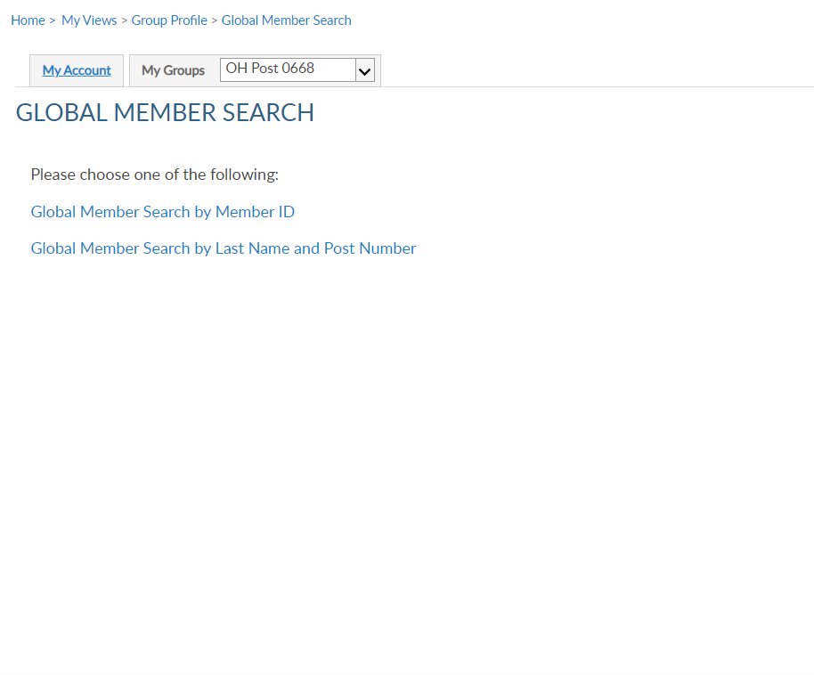

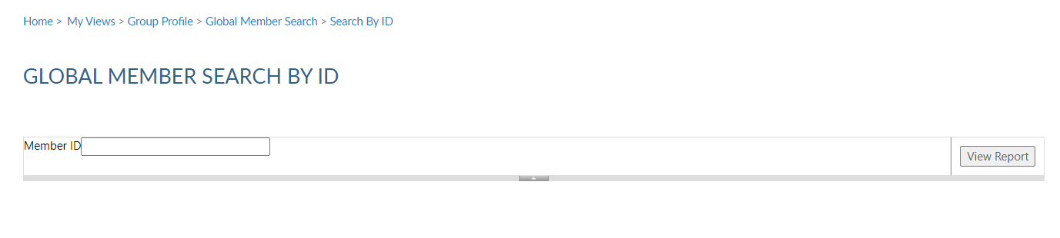
IMPORTANT INFO
Notes:
Global member search allows you to view members outside of your group. 2 options are provided. Search by ID or search by name with post number.
<1> Search by ID allows you to enter a Legion or Son of The American Legion membership number to view limited information. Enter the ID#, click View Report <2> to view name, member type, paid post or squadron, and last paid year.

Slide 14
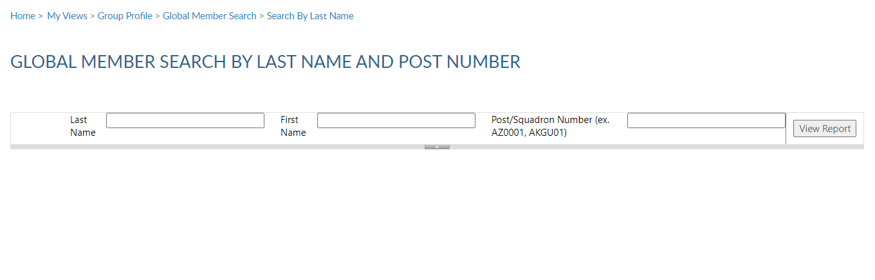
IMPORTANT INFO
Notes:
Search by last name and number requires both pieces of information. Click View Report to view. <1>
This information can assist with transferring members and eligibility for The American Legion Auxiliary and Sons of the American Legion.

Slide 15
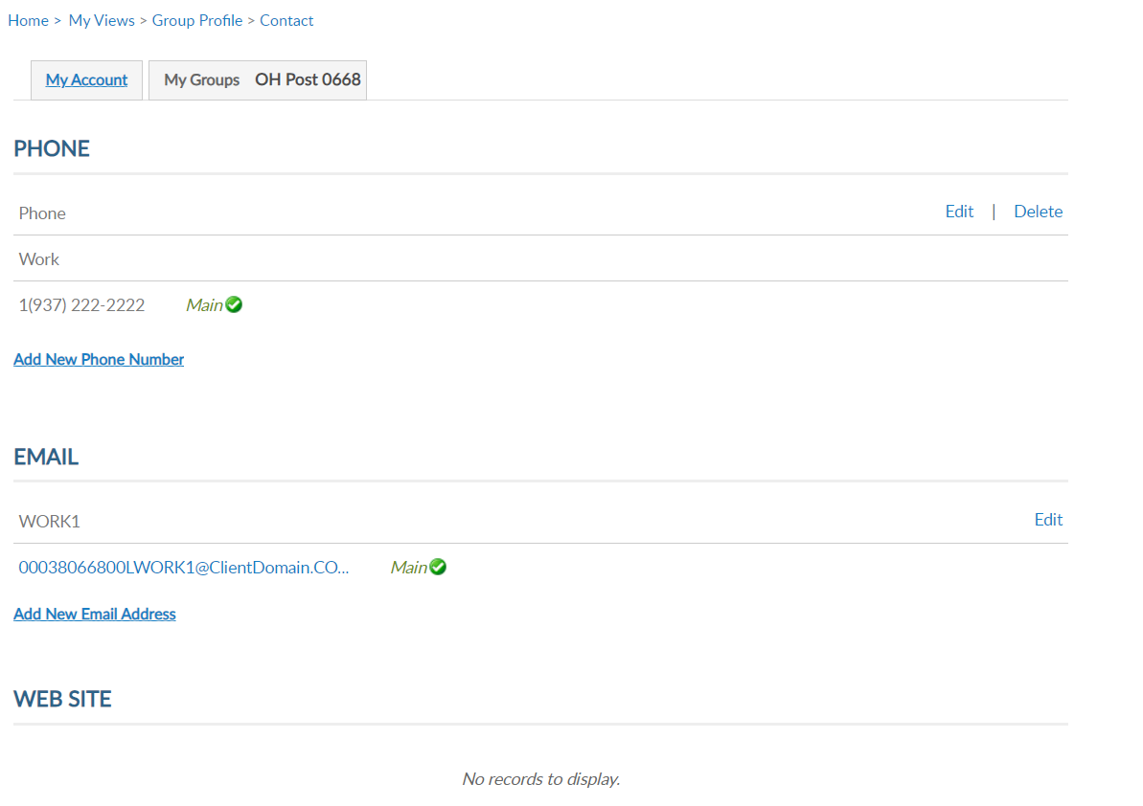

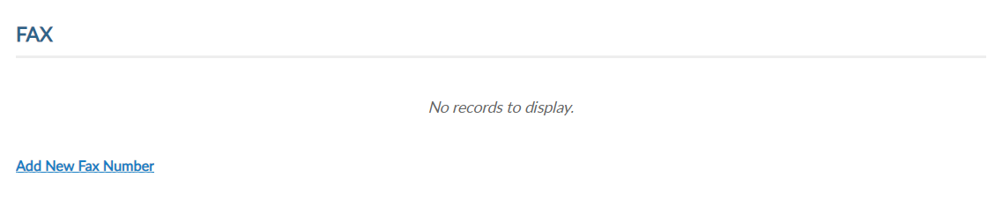
GROUP CONTACT INFO
Notes:
Group information allows updates to basic contact information including phone, email website and fax. Use the Add, Edit or Delete options to update group contact information.

Slide 16
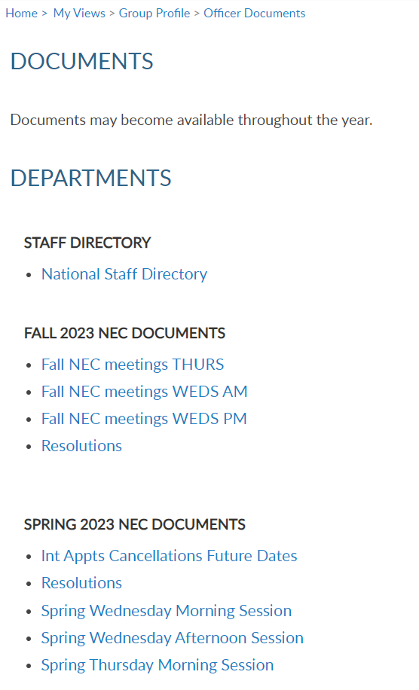
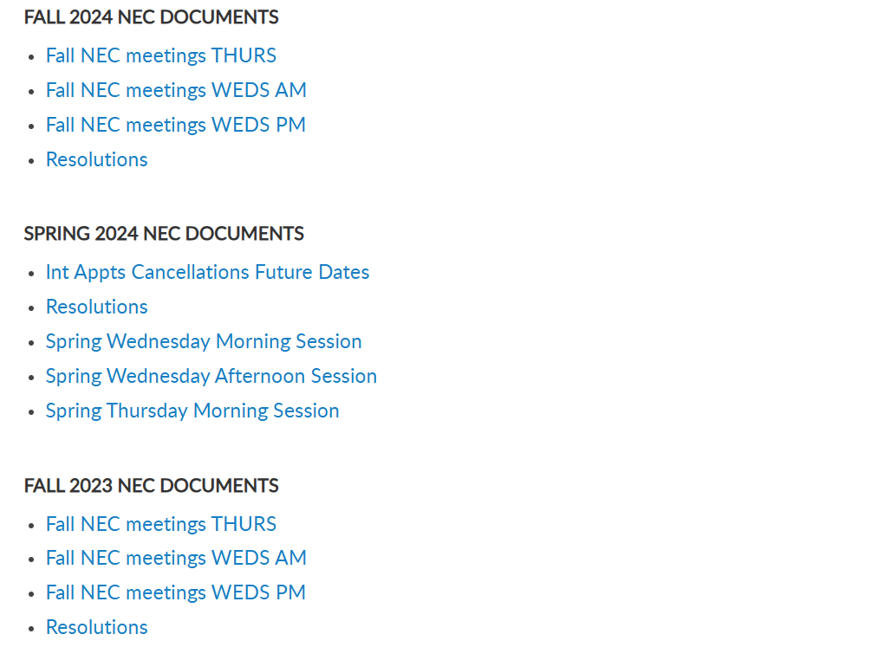
MATERIALS > DOCUMENTS
Notes:
Materials include NEC documents, manuals, brochures, and suggested speeches. The documents area includes a national staff directory, and minutes from the National Executive Committee meetings.

Slide 17
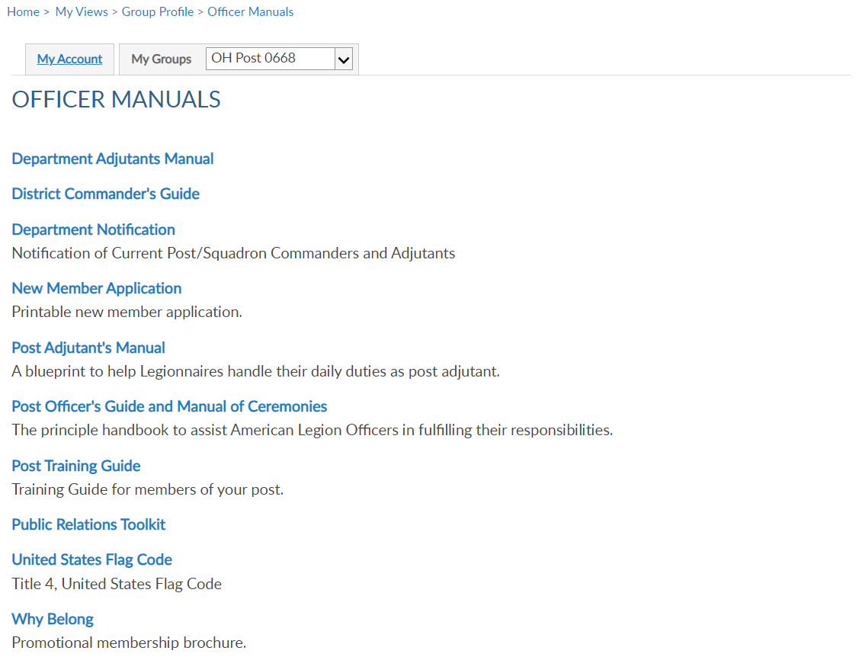
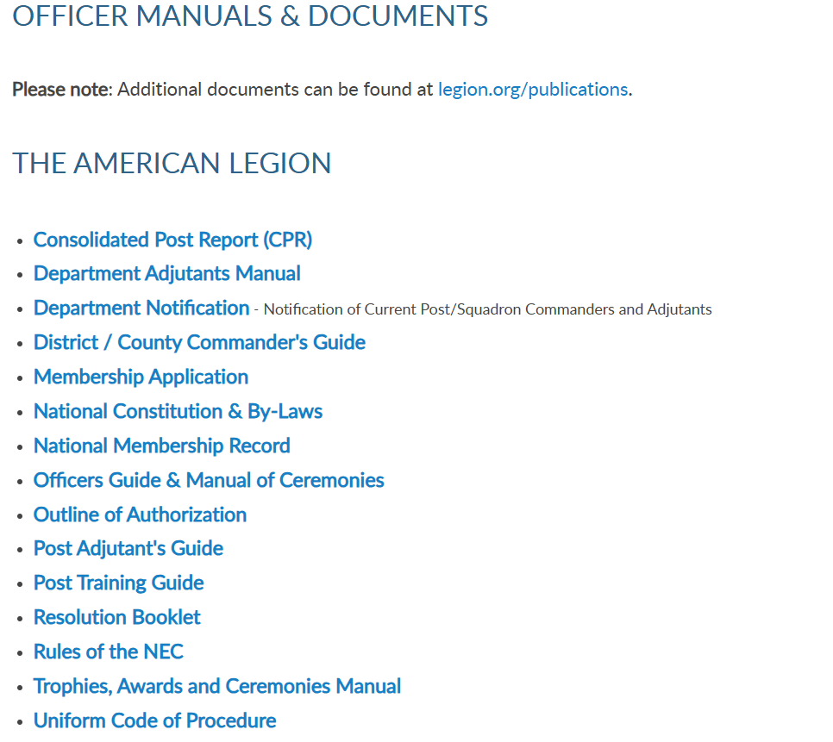
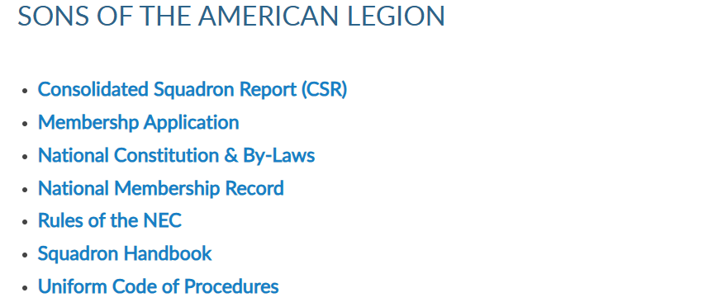
MATERIALS
Notes:
Officer Manuals are available to download. Select the title to link to publications on Legion.org to download.

Slide 18
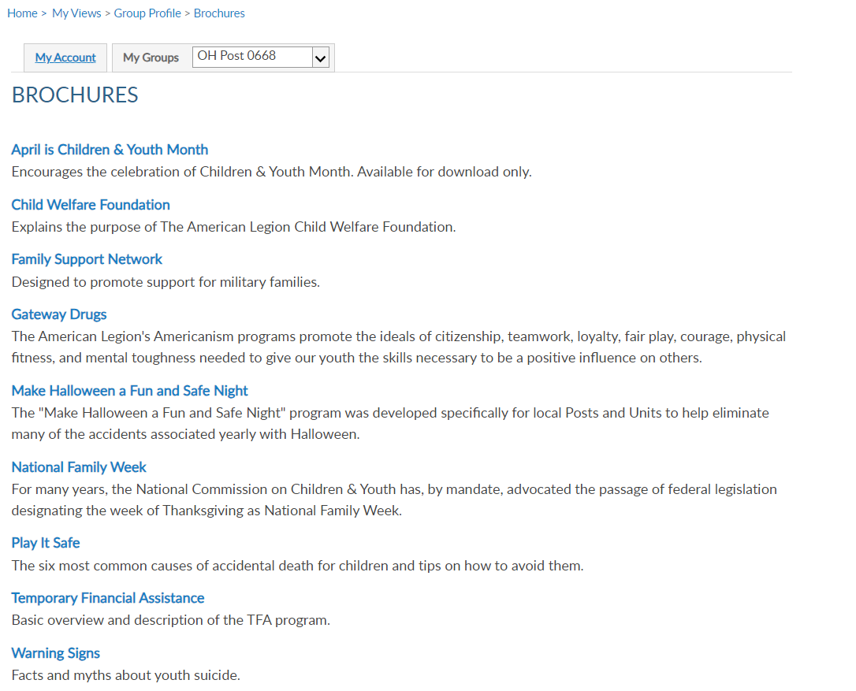
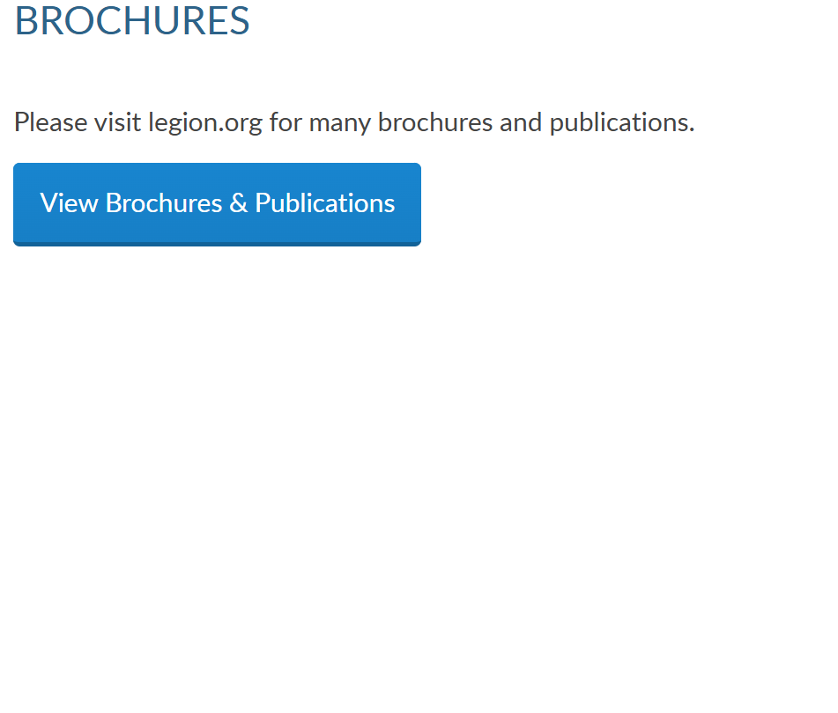
MATERIALS
Notes:
Brochures are national publications related to Americanism and Children & Youth services.

Slide 19
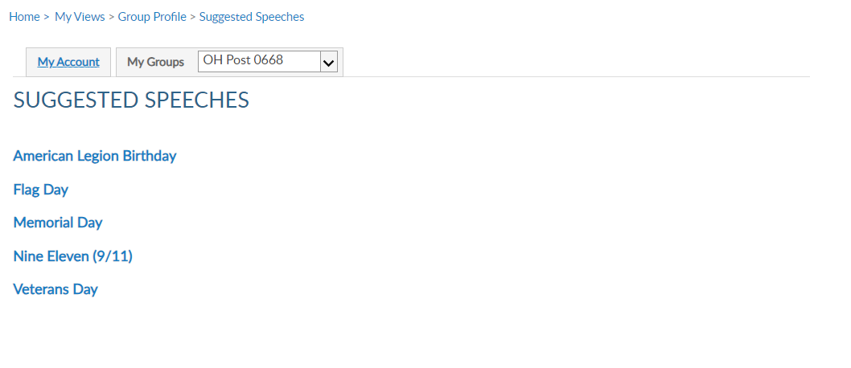
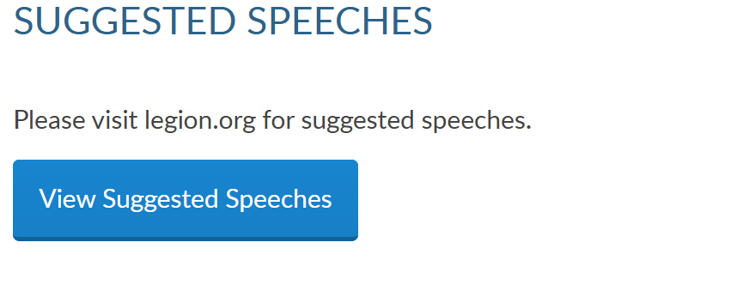
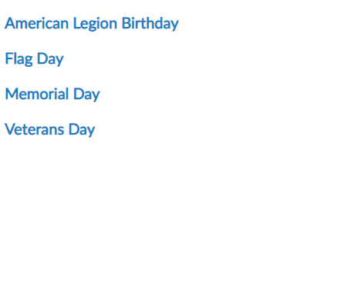
MATERIALS
Notes:
Every year The American Legion provides speeches to use as a guideline during events and observances. These speeches can be downloaded in the myLegion.

Slide 20
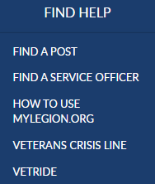
Online Help
000123456789
PrimaryEmailAddress.com
000123456789
Notes:
Online help is available from the top Menu “Find Help”.
Step by step instructions, videos and training presentations will assist with how to manage groups in MyLegion.

Slide 21
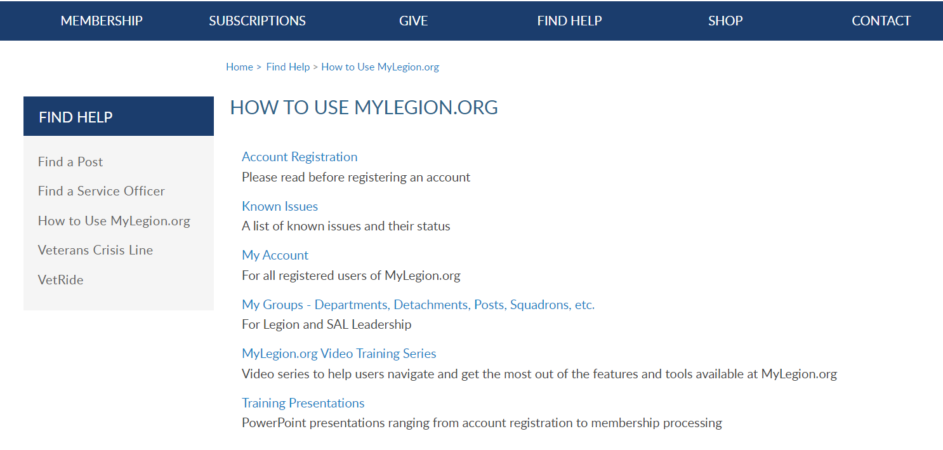
Online Help
Notes:
Step by step instructions, videos and training presentations will assist with how to manage groups in MyLegion. My Groups instructions include managing membership, online, membership processing, reports and all other administrative tasks.

Slide 22
MYLEGION SUPPORT
MyLegion@legion.org
833.253.9995
Monday – Friday
8:00am – 4:30pm
(Eastern)
The American Legion National HQs
5745 Lee Road
Indianapolis, IN 46216
Contact your MyLegion support team to assist with any questions or tools on your MyLegion account.
Notes:
Contact your myLegion support team to assist with questions and tools for MyLegion. Email mylegion@legion.org or call 833-253-9995 Monday through Friday.

